Slide 1



Numeral Systems
http://csharpfundamentals.telerik.com
Binary, Decimal and Hexadecimal Numbers
Svetlin Nakov
Technical Trainer
www.nakov.com
Telerik Software Academy
academy.telerik.com

Slide 2

Table of Contents
Numerals Systems
Binary and Decimal Numbers
Hexadecimal Numbers
Conversion between Numeral Systems
Representation of Numbers
Positive and Negative Integer Numbers
Floating-Point Numbers
Text Representation

Slide 3


Numeral Systems
Conversion between Numeral Systems

Slide 4

Decimal Numbers
Decimal numbers (base 10)
Represented using 10 numerals: 0, 1, 2, 3, 4, 5, 6, 7, 8, 9
Each position represents a power of 10:
401 = 4*10² + 0*10¹ + 1*10⁰ = 400 + 1
130 = 1*10² + 3*10¹ + 0*10⁰ = 100 + 30
9786 = 9*10³ + 7*10² + 8*10¹ + 6*10⁰ = = 9*1000 + 7*100 + 8*10 + 6*1

Slide 5
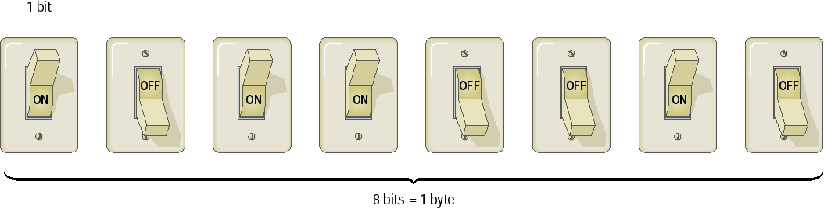
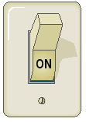
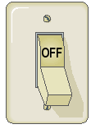
Binary Numeral System
Binary numbers are represented by sequence of bits (smallest unit of information – 0 or 1)
Bits are easy to represent in electronics
1 0 0 1 0 0 1 0
1 0 0 1 0 0 1 1
1 1 1 1 1 1 1 1
1 0 1 1 0 0 1 0

Slide 6

Binary Numbers
Binary numbers (base 2)
Represented by 2 numerals: 0 and 1
Each position represents a power of 2:
101_{b} = 1*2² + 0*2¹ + 1*2⁰ = 100_{b} + 1_{b} = 4 + 1 =
= 5
110_{b} = 1*2² + 1*2¹ + 0*2⁰ = 100_{b} + 10_{b} = 4 + 2 =
= 6
110101_{b} = 1*2⁵ + 1*2⁴ + 0*2³ + 1*2² + 0*2¹ + 1*2⁰ =
= 32 + 16 + 4 + 1 = = 53

Slide 7
Binary to Decimal Conversion
Multiply each numeral by its exponent:
1001_{b} = 1*2³ + 1*2⁰ = 1*8 + 1*1 =
= 9
0111_{b} = 0*2³ + 1*2² + 1*2¹ + 1*2⁰ = = 100_{b} + 10_{b} + 1_{b} = 4 + 2 + 1 =
= 7
110110_{b} = 1*2⁵ + 1*2⁴ + 0*2³ + 1*2² + 1*2¹ = = 100000_{b} + 10000_{b} + 100_{b} + 10_{b} = = 32 + 16 + 4 + 2 = = 54

Slide 8
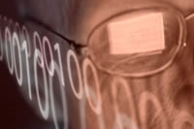
Decimal to Binary Conversion
Divide by 2 and append the reminders in reversed order:
500/2 = 250 (0)
250/2 = 125 (0)
125/2 = 62 (1)
62/2 = 31 (0) 500_{d} = 111110100_{b}
31/2 = 15 (1)
15/2 = 7 (1)
7/2 = 3 (1)
3/2 = 1 (1)
1/2 = 0 (1)

Slide 9

Hexadecimal Numbers
Hexadecimal numbers (base 16)
Represented using 16 numerals: 0, 1, 2, ... 9, A, B, C, D, E and F
Usually prefixed with 0x
0 → 0x0 8 → 0x8
1 → 0x1 9 → 0x9
2 → 0x2 10 → 0xA
3 → 0x3 11 → 0xB
4 → 0x4 12 → 0xC
5 → 0x5 13 → 0xD
6 → 0x6 14 → 0xE
7 → 0x7 15 → 0xF

Slide 10

Hexadecimal Numbers (2)
Each position represents a power of 16:
9786_{hex} = 9*16³ + 7*16² + 8*16¹ + 6*16⁰ =
= 9*4096 + 7*256 + 8*16 + 6*1 =
= 38790
0xABCDEF_{hex} = 10*16⁵ + 11*16⁴ + 12*16³ +
13*16² + 14*16¹ + 15*16⁰ =
= 11259375

Slide 11

Hexadecimal to Decimal Conversion
Multiply each digit by its exponent
1F4_{hex} = 1*16² + 15*16¹ + 4*16⁰ =
= 1*256 + 15*16 + 4*1 =
= 500_{d}
FF_{hex} = 15*16¹ + 15*16⁰ = = 240 + 15 =
= 255_{d}

Slide 12
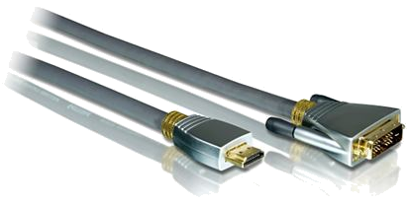
Decimal to Hexadecimal Conversion
Divide by 16 and append the reminders in reversed order
500/16 = 31 (4)
31/16 = 1 (F) 500_{d} = 1F4_{hex}
1/16 = 0 (1)

Slide 13
Binary to Hexadecimal (and Back) Conversion
The conversion from binary to hexadecimal (and back) is straightforward: each hex digit corresponds to a sequence of 4 binary digits:
0x0 = 0000 0x8 = 1000 0x1 = 0001 0x9 = 1001 0x2 = 0010 0xA = 1010 0x3 = 0011 0xB = 1011 0x4 = 0100 0xC = 1100 0x5 = 0101 0xD = 1101 0x6 = 0110 0xE = 1110 0x7 = 0111 0xF = 1111

Slide 14
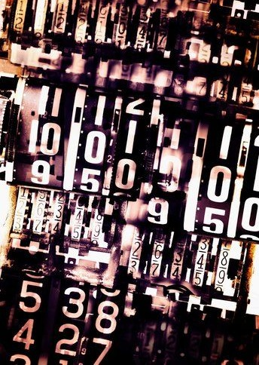
Numbers Representation
Positive and Negative Integers and Floating-Point Numbers

Slide 15
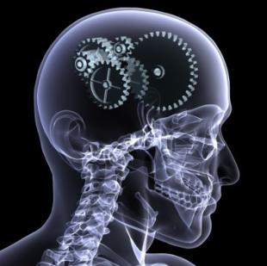
Representation of Integers
A short is represented by 16 bits
100 = 2⁶ + 2⁵ + 2² = = 00000000 01100100
An int is represented by 32 bits
65545 = 2¹⁶ + 2³ + 2⁰ =
= 00000000 00000001 00000000 00001001
A char is represented by 16 bits
'0' = 48 = 2⁵ + 2⁴ = = 00000000 00110000

Slide 16
Positive and Negative Numbers
A number's sign is determined by the Most Significant Bit (MSB)
Only in signed integers: sbyte, short, int, long
Leading 0 means positive number
Leading 1 means negative number
Example: (8 bit numbers)
0XXXXXXX_{b} > 0 e.g. 00010010_{b} = 18
00000000_{b} = 0
1XXXXXXX_{b} < 0 e.g. 10010010_{b} = -110

Slide 17
Positive and Negative Numbers (2)
The largest positive 8-bit sbyte number is: 127 (2⁷ - 1) = 01111111_{b}
The smallest negative 8-bit number is: -128 (-2⁷) = 10000000_{b}
The largest positive 32-bit int number is: 2 147 483 647 (2³¹ - 1) = 01111…11111_{b}
The smallest negative 32-bit number is: -2 147 483 648 (-2³¹) = 10000…00000_{b}

Slide 18
Representation of 8-bit Numbers
Positive 8-bit numbers have the format 0XXXXXXX
Their value is the decimal of their last 7 bits (XXXXXXX)
Negative 8-bit numbers have the format 1YYYYYYY
Their value is 128 (2⁷) minus (-) the decimal of YYYYYYY
10010010_{b} = 2⁷ – 10010_{b} =
= 128 - 18 = -110
+127 = 01111111
...
+3 = 00000011
+2 = 00000010
+1 = 00000001
+0 = 00000000
-1 = 11111111
-2 = 11111110
-3 = 11111101
...
-127 = 10000001
-128 = 10000000

Slide 19
Floating-Point Numbers
Floating-point numbers representation (according to the IEEE 754 standard*):
Example:
2
k
-
1
2
0
2
-
1
2
-
2
2
-
n
S
P
0
...
P
k
-
1
M
0
M
1
...
M
n
-
1
Sign
Exponent
Mantissa
* See http://en.wikipedia.org/wiki/Floating_point
Bit
31
Bits [3
0
…
23
]
Bits [2
2
…
0
]
1 10000011 01010010100000000000000
Sign
=
-
1
Exponent
= 4
Mantissa =
1,3222656
25

Slide 20

Text Representation in Computer Systems

Slide 21
How Computers Represent Text Data?
A text encoding is a system that uses binary numbers (1 and 0) to represent characters
Letters, numerals, etc.
In the ASCII encoding each character consists of 8 bits (one byte) of data
ASCII is used in nearly all personal computers
In the Unicode (UTF-16) encoding each character consists of 16 bits (two bytes)
Can represent many alphabets

Slide 22
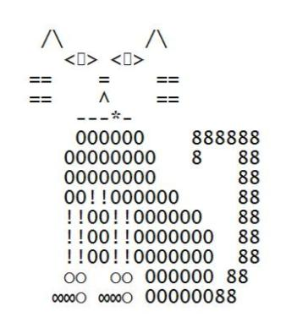
Character Codes – ASCII Table
Binary Code | Decimal Code | Character
01000001 | 65 | A
01000010 | 66 | B
01000011 | 67 | C
01000100 | 68 | D
00100011 | 35 | #
01100000 | 48 | 0
00110001 | 49 | 1
01111110 | 126 | ~
Excerpt from the
ASCII table
22

Slide 23
Strings of Characters
Strings are sequences of characters
Null-terminated (like in C)
Represented by array
Characters in the strings can be:
8 bit (ASCII / windows-1251 / …)
16 bit (UTF-16)
… | … | … | … | … | … | … | … | \0
4 bytes length | … | … | … | … | … | …
23

Slide 24


Numeral Systems
http://csharpfundamentals.telerik.com

Slide 25
Exercises
Write a program to convert decimal numbers to their binary representation.
Write a program to convert binary numbers to their decimal representation.
Write a program to convert decimal numbers to their hexadecimal representation.
Write a program to convert hexadecimal numbers to their decimal representation.
Write a program to convert hexadecimal numbers to binary numbers (directly).
Write a program to convert binary numbers to hexadecimal numbers (directly).

Slide 26
Exercises (2)
Write a program to convert from any numeral system of given base s to any other numeral system of base d (2 ≤ s, d ≤ 16).
Write a program that shows the binary representation of given 16-bit signed integer number (the C# type short).
* Write a program that shows the internal binary representation of given 32-bit signed floating-point number in IEEE 754 format (the C# type float). Example: -27,25 → sign = 1, exponent = 10000011, mantissa = 10110100000000000000000.

Slide 27




Free Trainings @ Telerik Academy
“C# Programming @ Telerik Academy
csharpfundamentals.telerik.com
Telerik Software Academy
academy.telerik.com
Telerik Academy @ Facebook
facebook.com/TelerikAcademy
Telerik Software Academy Forums
forums.academy.telerik.com

